Slide 1
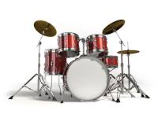
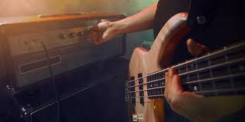
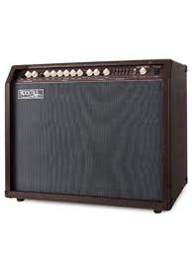
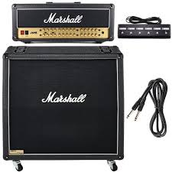
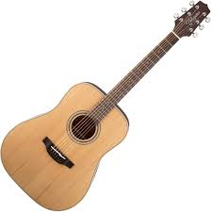
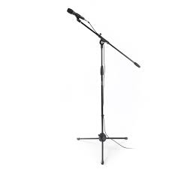
FIVE - Connected
Bühnenplan / Kanalbelegungen
Drums / Oli
230V
230V
230V
Bass
J.J.
Akustikgitarre & Gesang
Torben
Gesang
Rebecca
E-Gitarre & Gesang
Lemmi
230V
230V
Kanalbelegung:
Instrument / Quelle | Kanal | Hinweis
Kick | 1
Snare | 2
Hi-Hat | 3
Hi Tom | 4
Mid Tom | 5
Floor Tom | 6
OH L | 7
OH R | 8
Vocals J.J. | 9 | SM 58
Vocals Torben | 10 | SM 58
Vocals Rebecca | 11 | SM 58
Vocals Lemmi | 12 | SM 58
Vocals Olli | 13 | SM 58
Bass Amp J.J. | 14 | DI (XLR)
ACC-Gitarre Torben | 15 | DI (XLR)
E-Gitarre Lemmi | 16 | Mik

